Slide 1

App Name:
GrocerGrid

Slide 2
Overview
Sign up profile
Login in profile
Home
Navigation Bar
Category List
Empty Cart
New Products Updates
Available Products
Product Details
Order Cart
Admin Panel

Slide 3

User View
Splash screen.

Slide 4
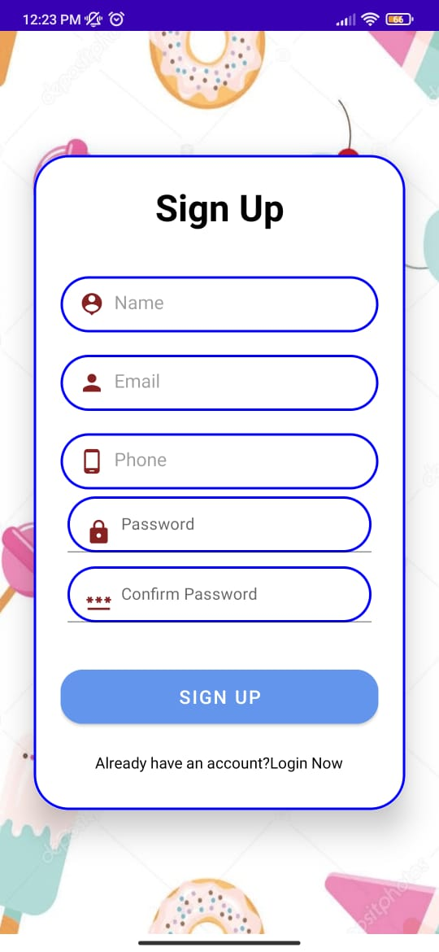
User can register their information and create their account.

Slide 5
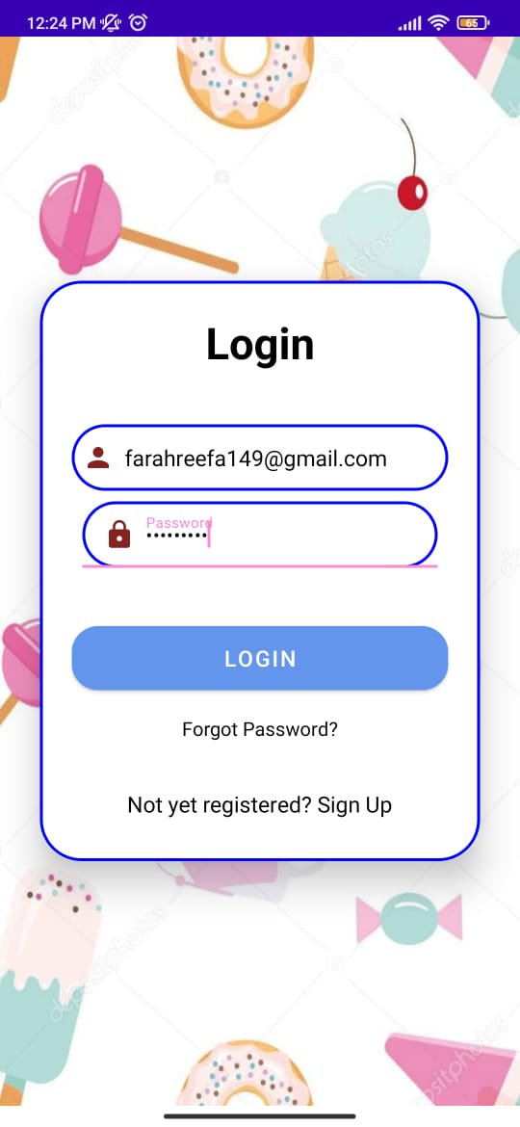
User Login details.

Slide 6
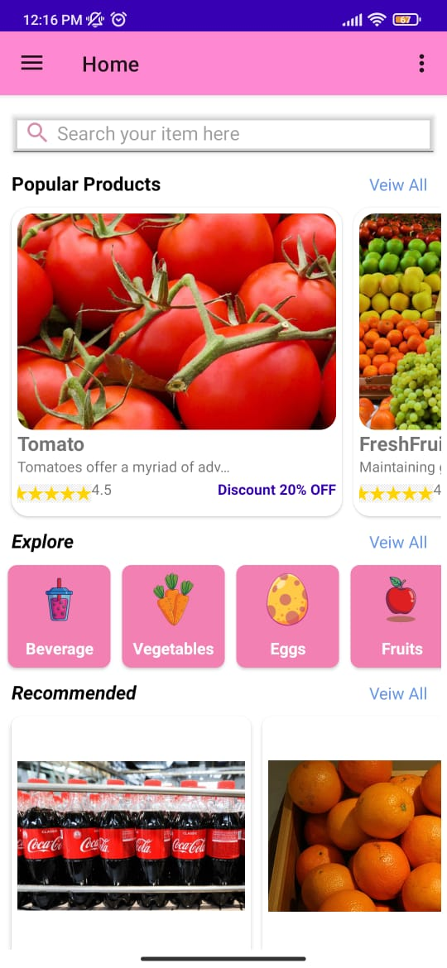
Home Page contains details of all products & other features.

Slide 7
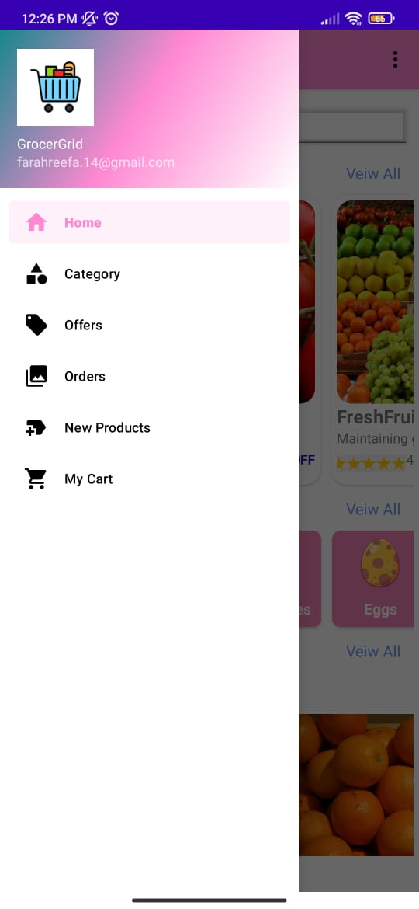
The Navigation drawer contains more options including Home, Category, Offers, Orders, New Products & My Cart.

Slide 8
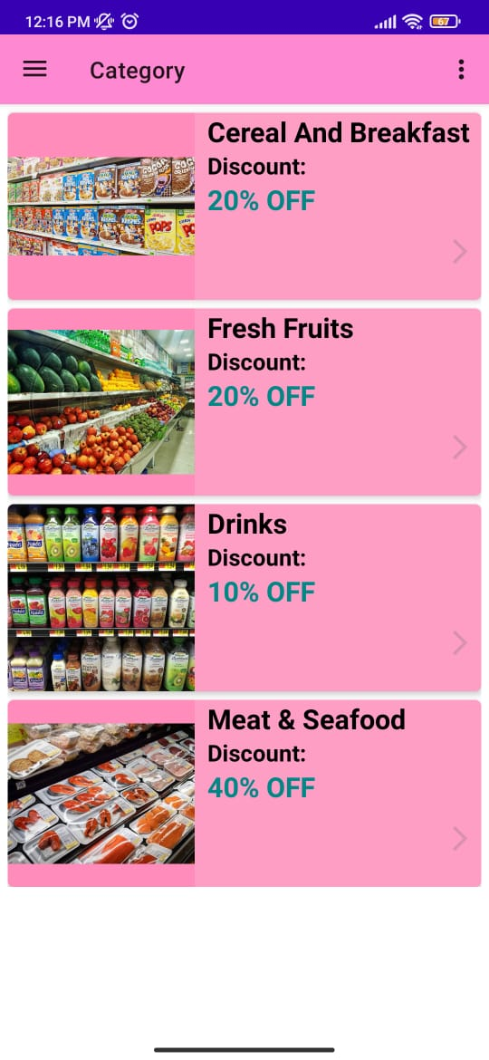
The Category contains list of all different kinds of products.

Slide 9
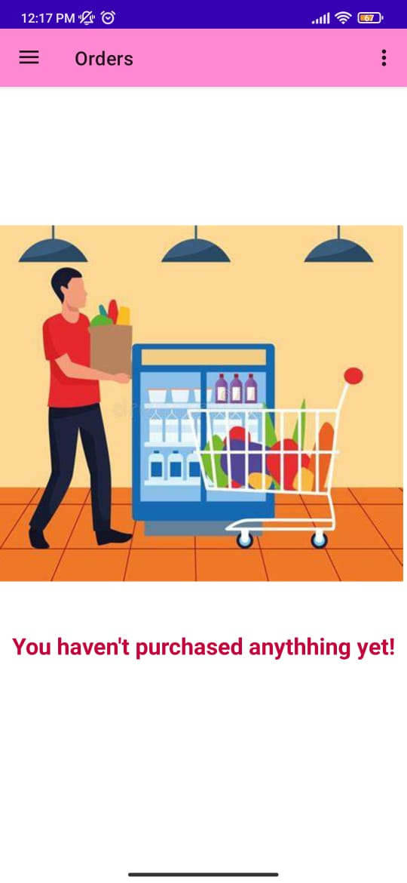
Initially the cart is empty.

Slide 10
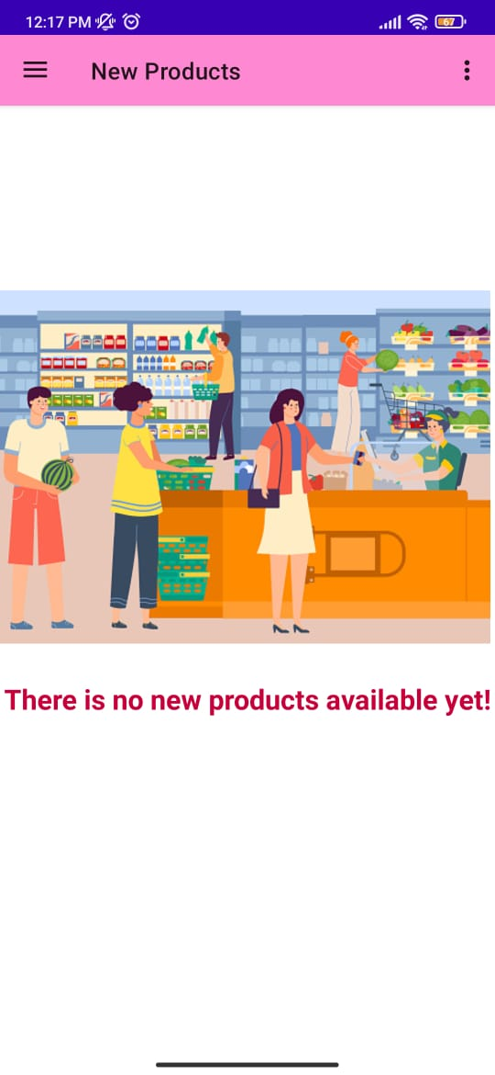
Updates of new products will be shown here.

Slide 11
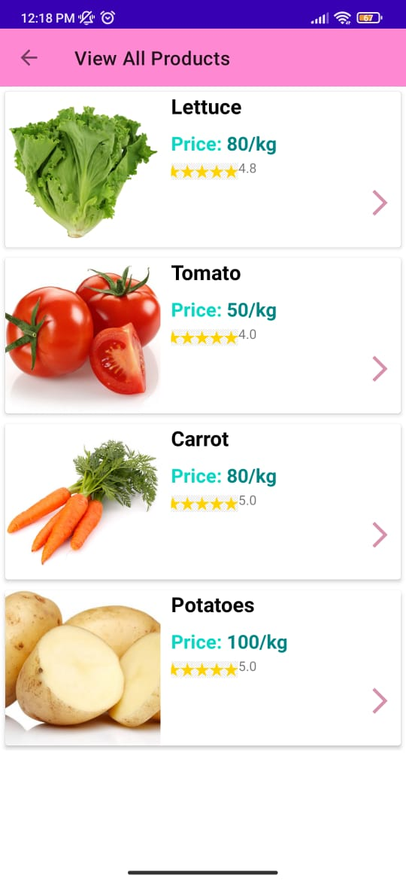
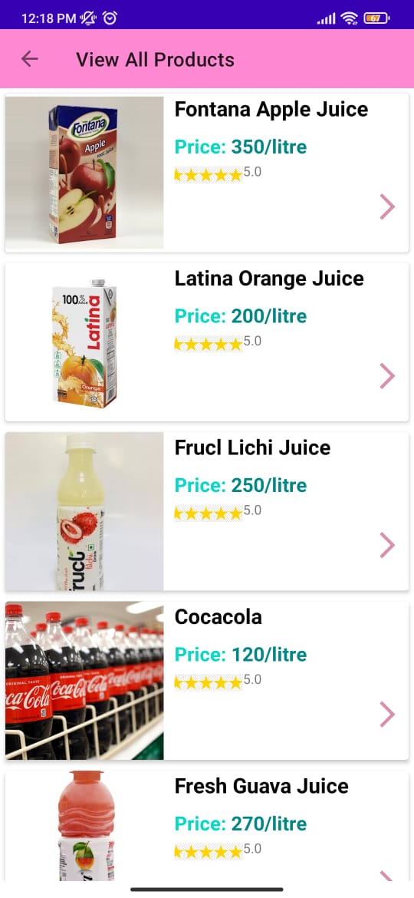
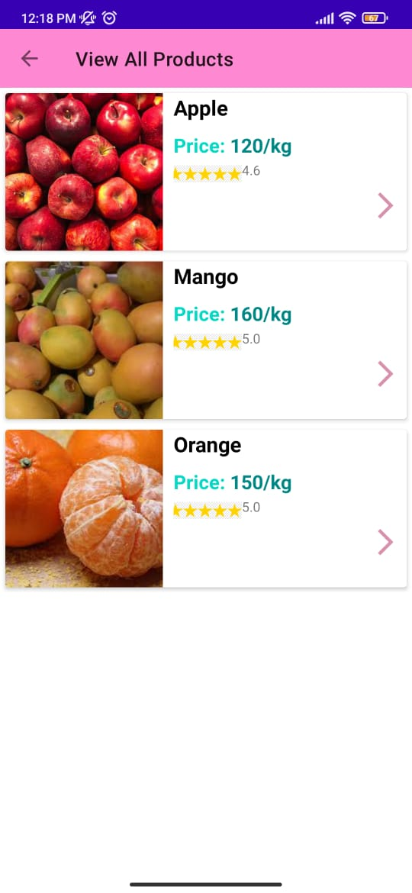
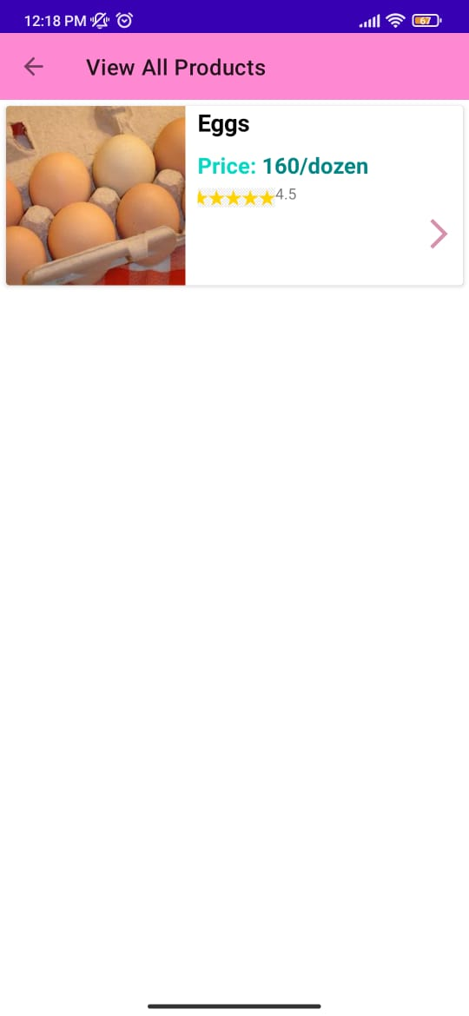
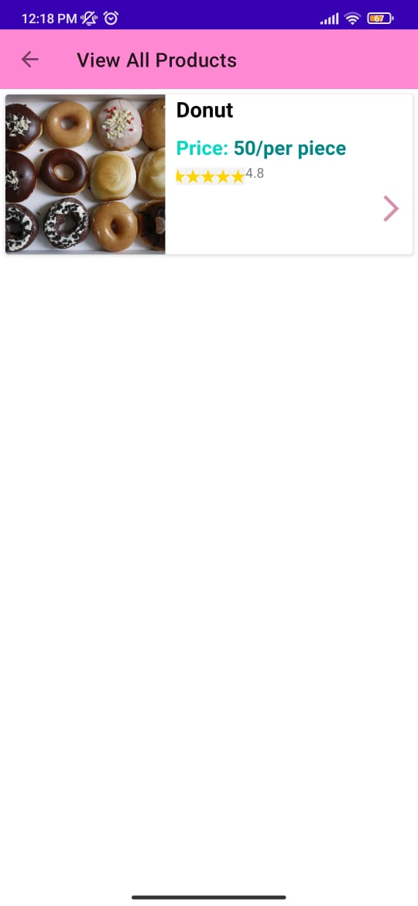
.

Slide 12
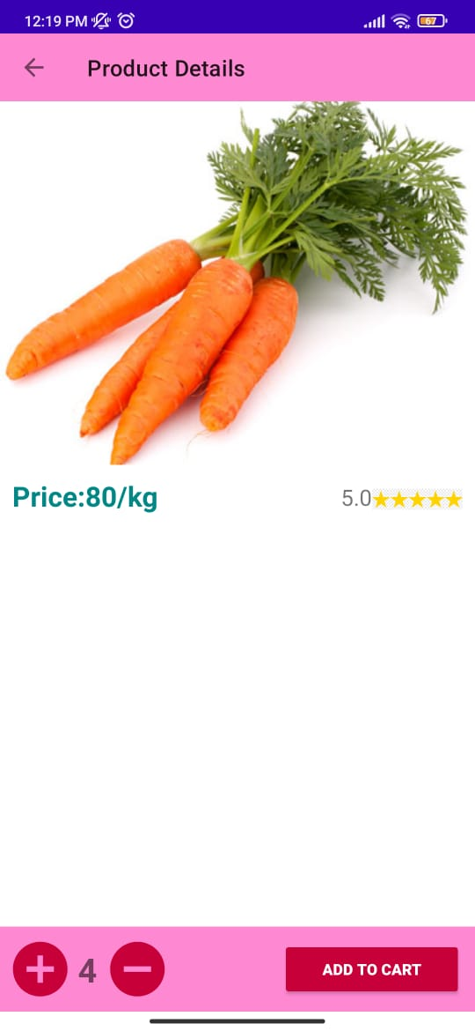
Products must be added to the cart to buy it.

Slide 13
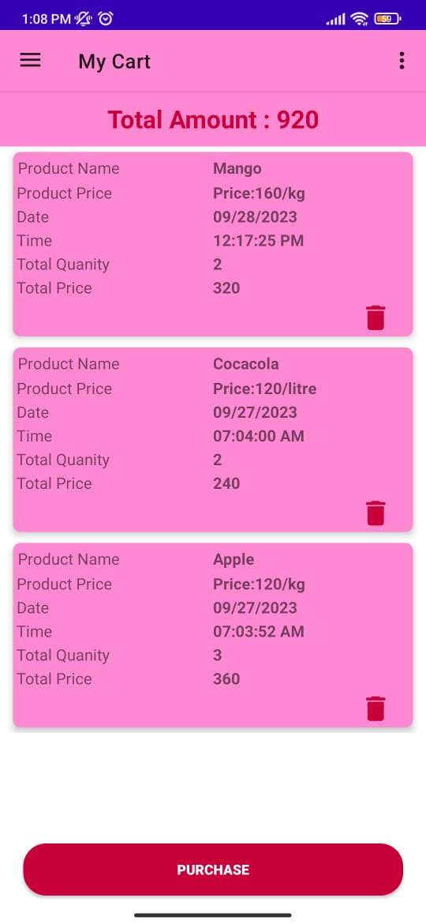
Order details of all the items added to the cart will be shown here.

Slide 14
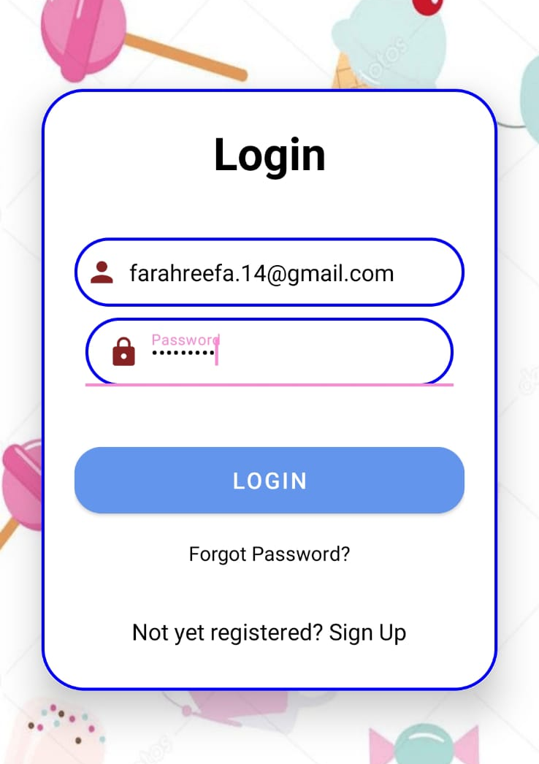
Admin Panel
Admin login details

Slide 15
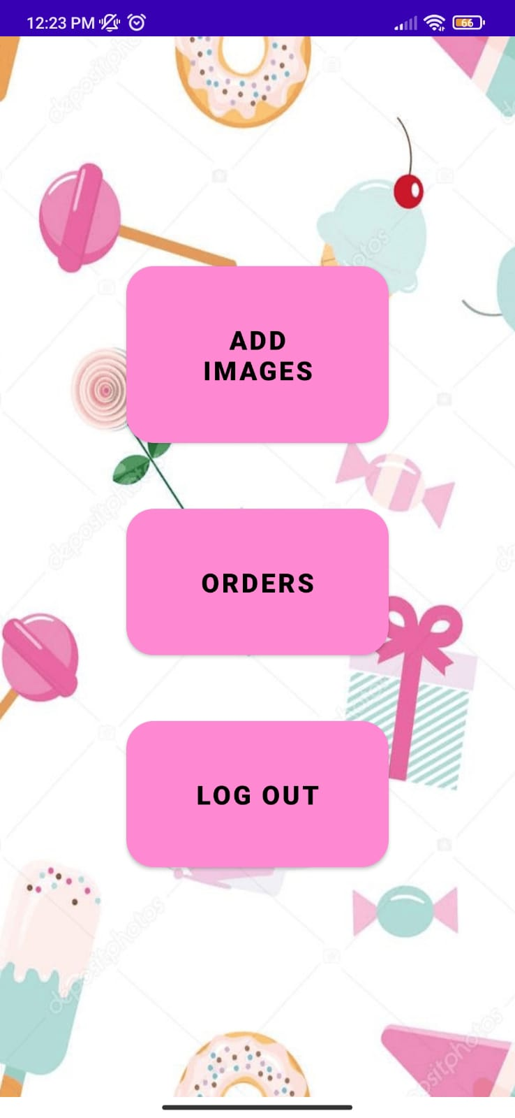
Admin panel options.

Slide 16
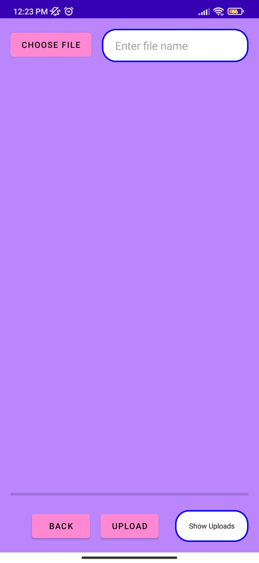
Admin can upload the images of products here.

Slide 17
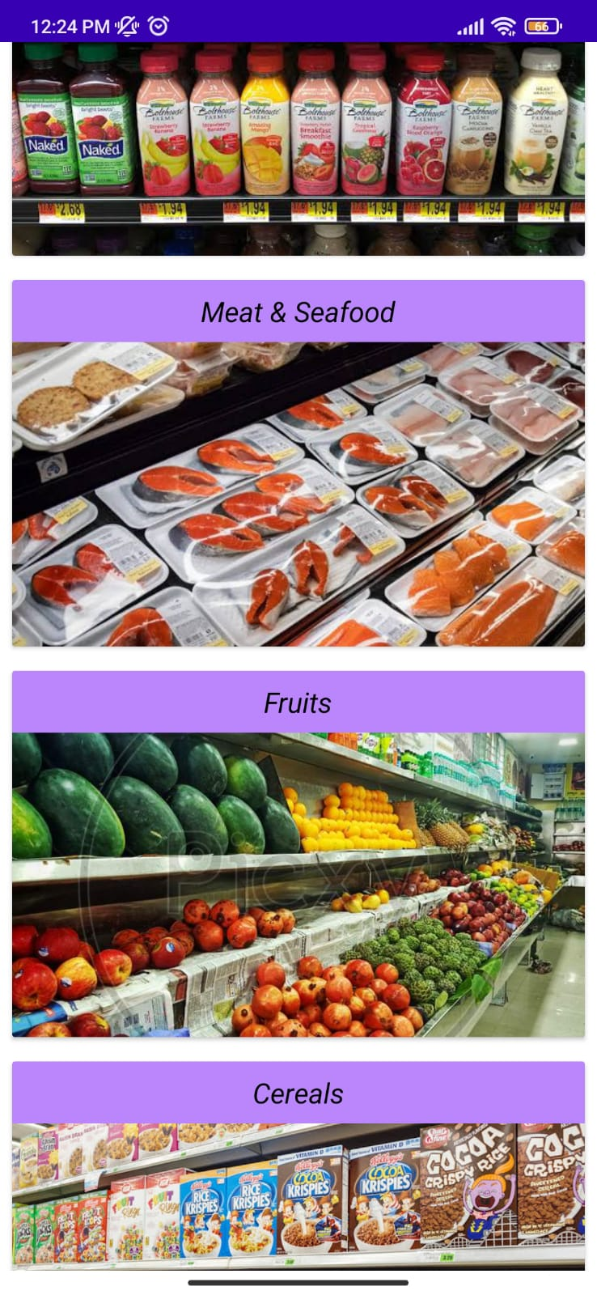
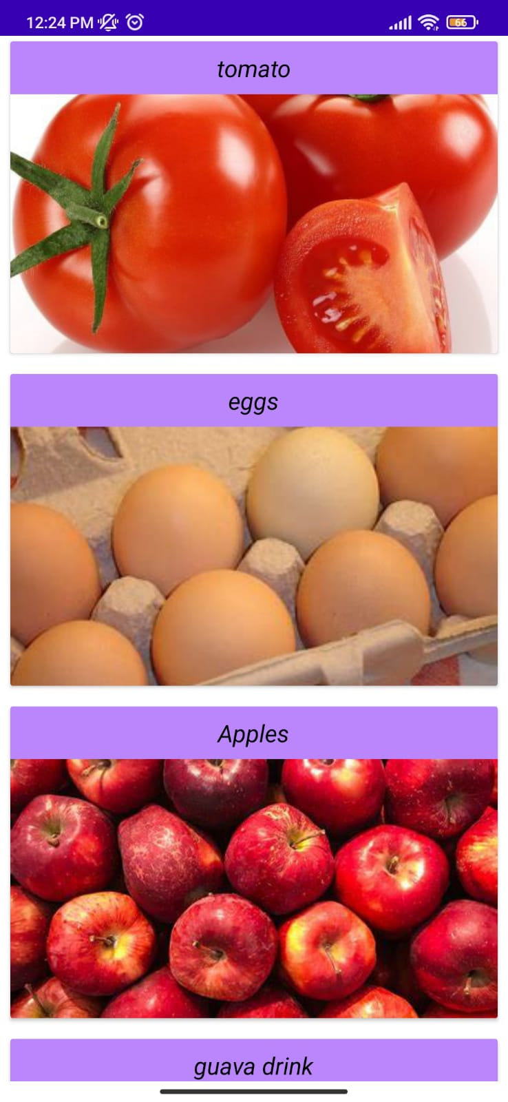
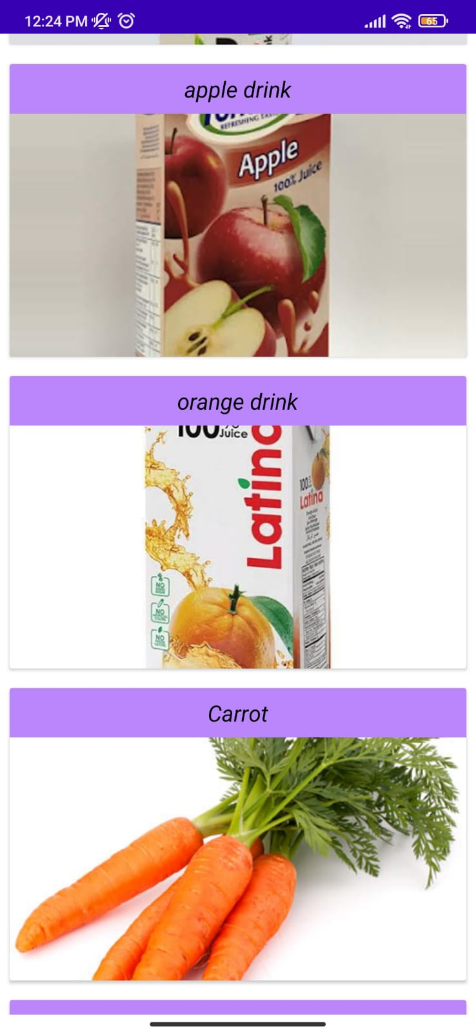
The uploaded images are displayed here.

Slide 18
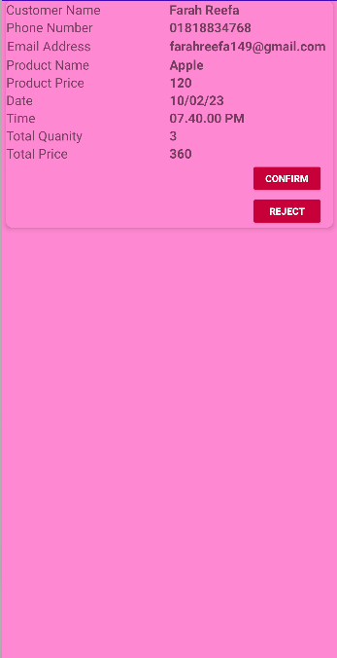
User Order details.

Slide 19
THANK YOU!

